Slide 1

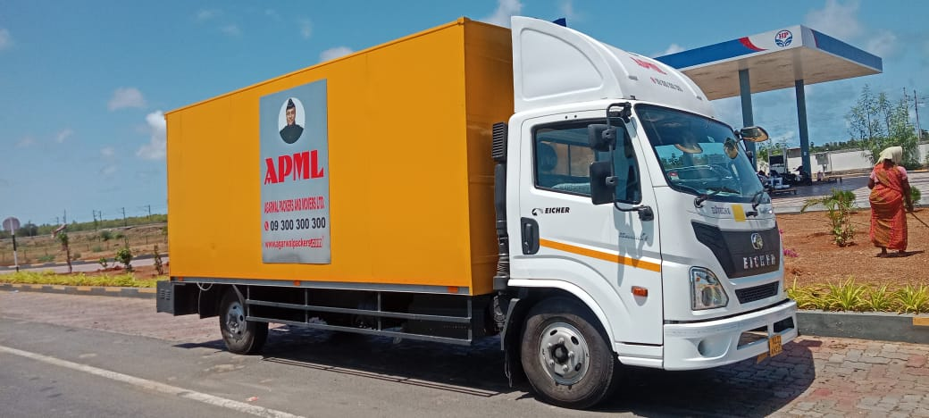
Smart Vehicle
From APML Commercial
  Specialized design for:
Auto Parts Goods Carrier
FMCG/ Pharma Goods Carrier
Medical Equipment’s Goods Carrier
And many many more…..
A differentiated cost economic experience
Next Generation Technology

Slide 2
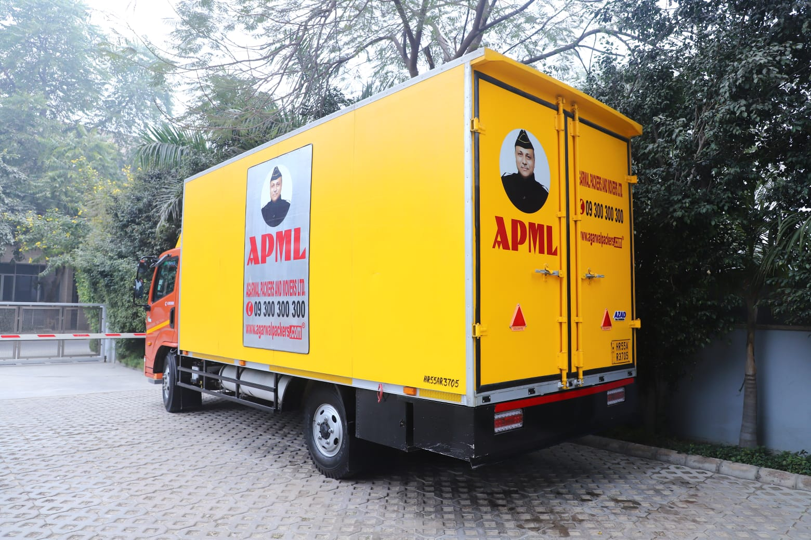
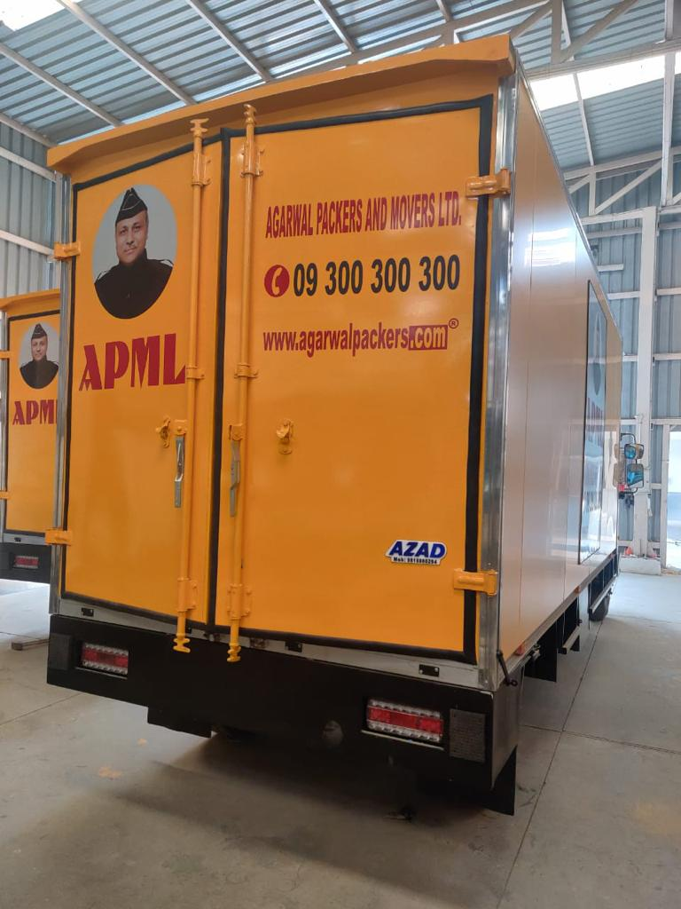
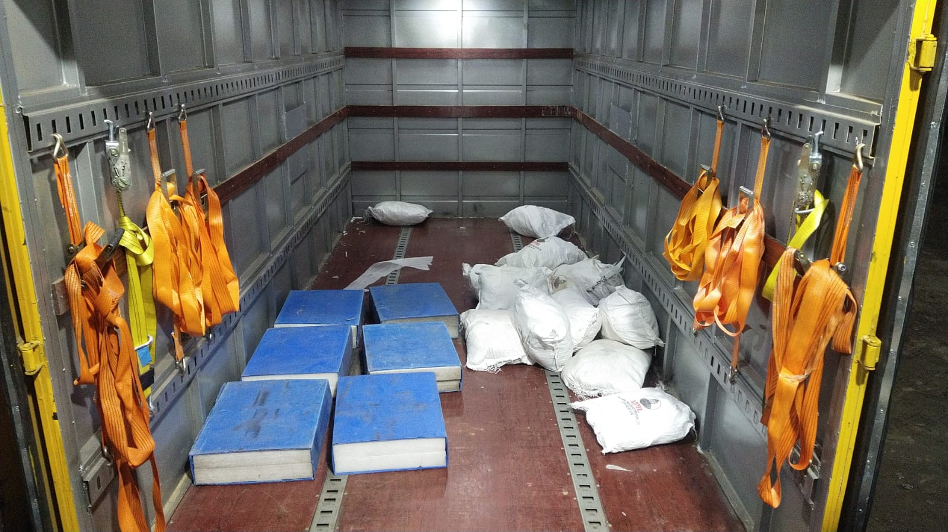
Smart Vehicle
A new benchmark in Transportation
BS VI CV Technology

Slide 3
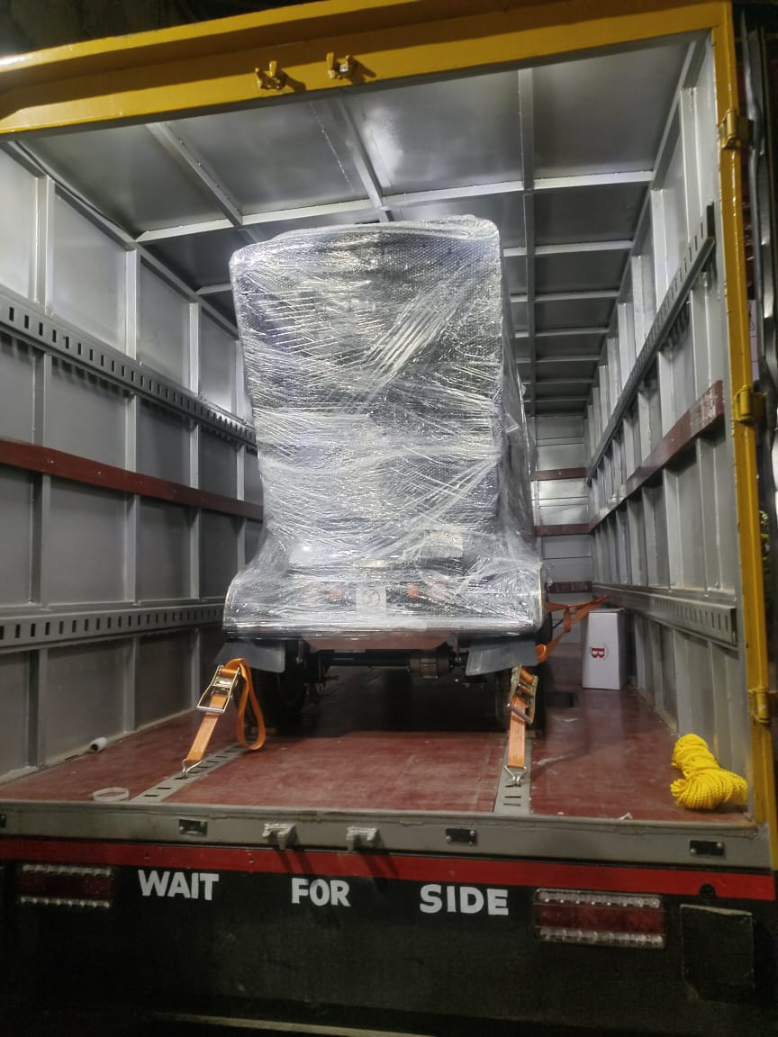
WHY SMART VEHICLE ?
IN-BUILT FEATURES
SAFETY BELTS
Secured Transportation: Goods are tightly fastened. Thus, reducing damage risk
Prevents dis-location of Goods
Prevention of cargo shift during transit, ensuring stability and safety.
Enhanced satisfaction through safe and damage-free deliveries
LED LIGHTS INSIDE
Improved visibility and illumination for nighttime operations.
Increased safety for drivers and cargo
Enhanced and unique appearance.
Also, no “no- entry” hassles

Slide 4


SMART VEHICLE- VEHICLE DIMENSIONS
APML’s innovative spirit has led to the creation of 17 FT & 12 FT SMART VEHICLE CONTAINER that redefines the transport industry standard.
Introducing next- generation trucking technology
APML 17 FEET SMART VEHICLES ARE DESIGNED TO CARRY LOADS UPTO 3.5 TONS
17 FT.
12 FT.
12 FT. SMART VEHICLE CONTAINER
17 FT. SMART VEHICLE CONTAINER
Dimensions :
Capacity :
Dimensions :
Capacity :
Length - 17 Feet
Length - 12 Feet
1.8 MT
Width - 7 Feet
3.5 MT
Width - 7 Feet
Height - 7 Feet
Height - 7 Feet

Slide 5
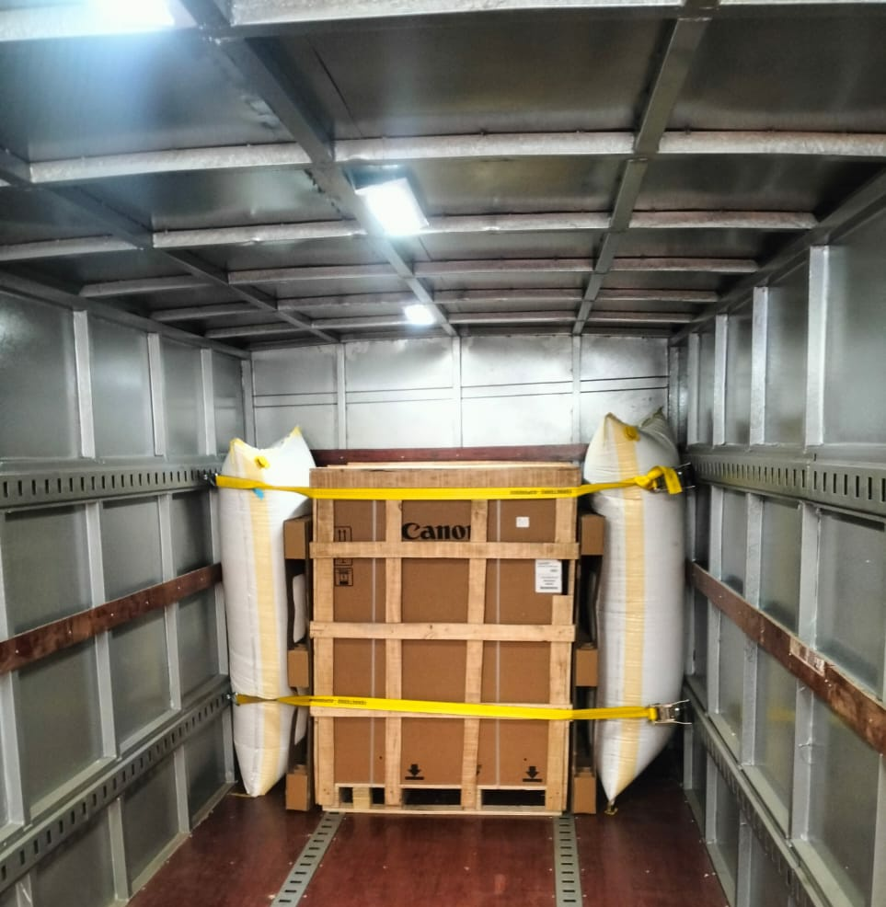
SUCCESS STORIES OF SMART VEHICLE TRIALS
CANON INDIA P LTD.
GURGAON TO SRINAGAR & BHIWANDI TO HYDERABAD
Ideal for transporting compact shipments and handling small loads of less than 20FT.
Approx. 300 boxes delivered in Hyderabad.
Ensuring in-transit safety and stability through safety belts.
OBSERVATIONS & ADVANTAGES

Slide 6
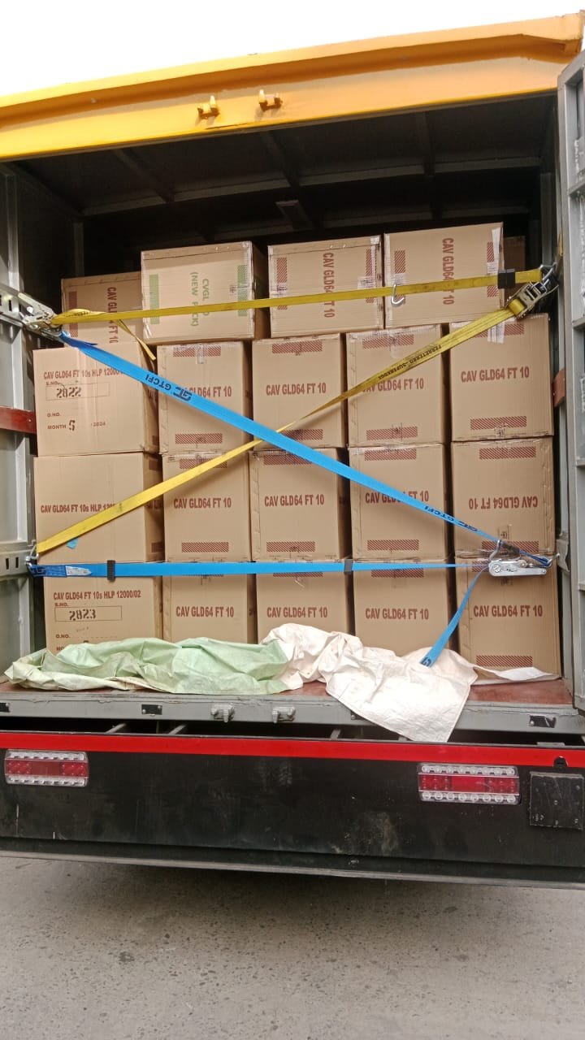
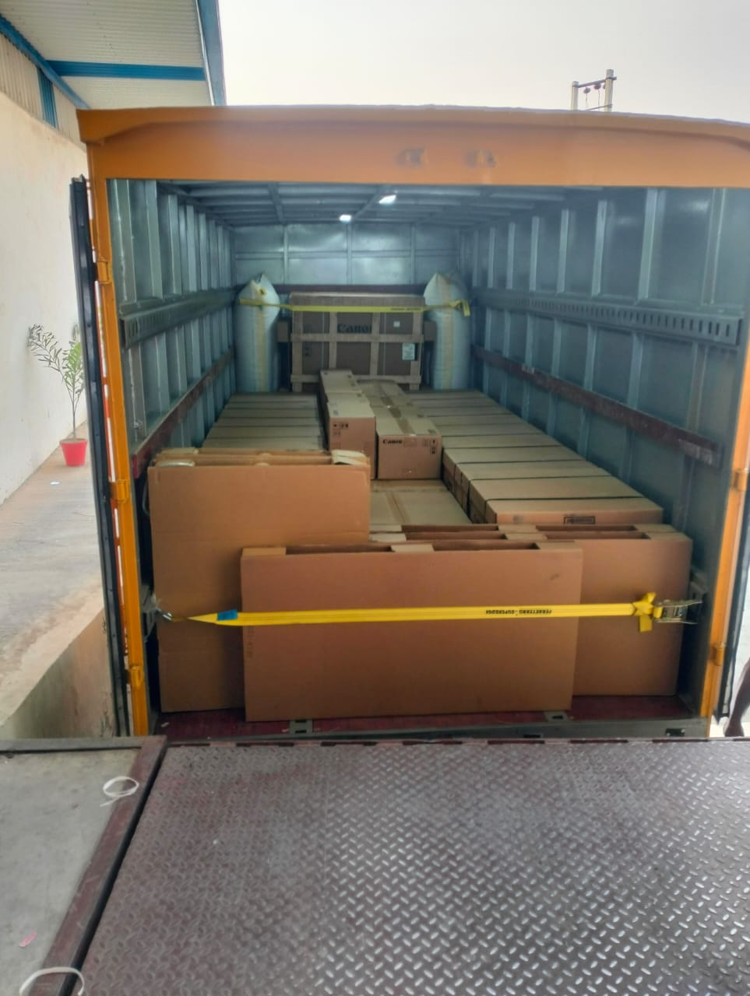
SUCCESS STORIES OF SMART VEHICLE TRIALS
GODFREY PHILLIPS INDIA LTD. - GHAZIABAD TO JALANDHAR
OBSERVATIONS & ADVANTAGES
Ideal for transporting compact shipments and handling small loads of less than 20FT.
210 boxes shipped to Jalandhar.
Ensuring in-transit safety and stability through safety belts

Slide 7
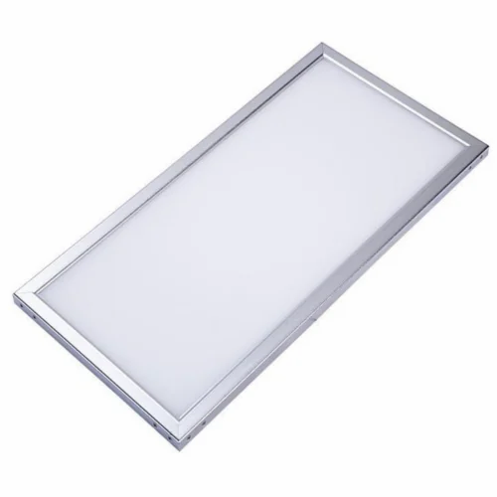
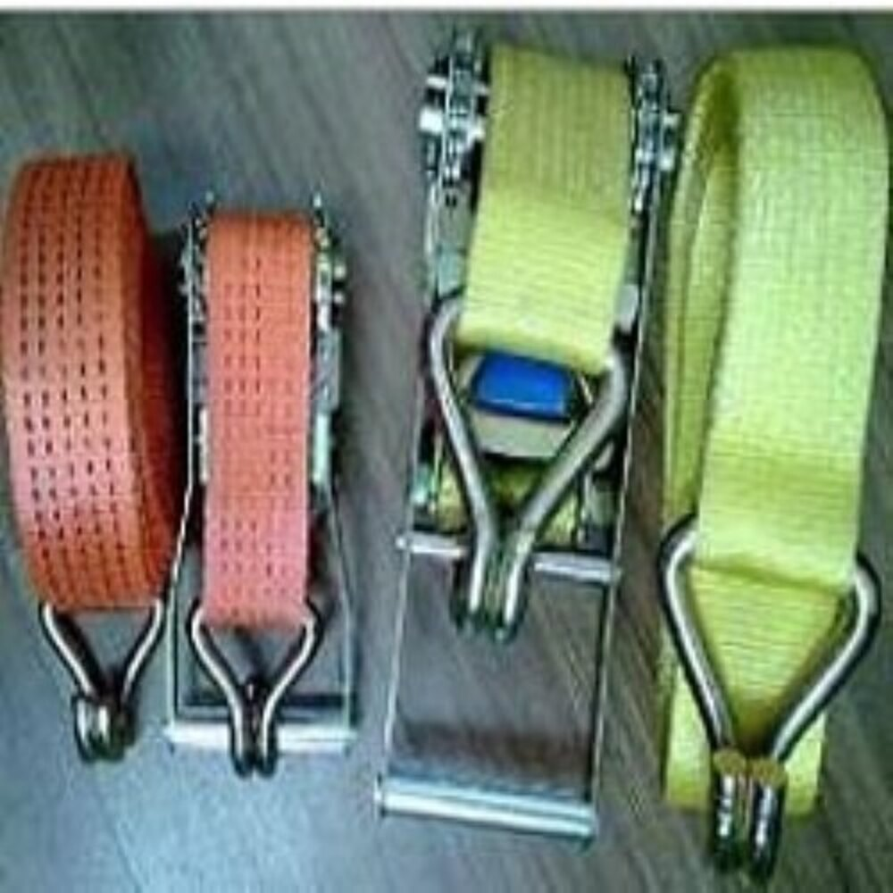
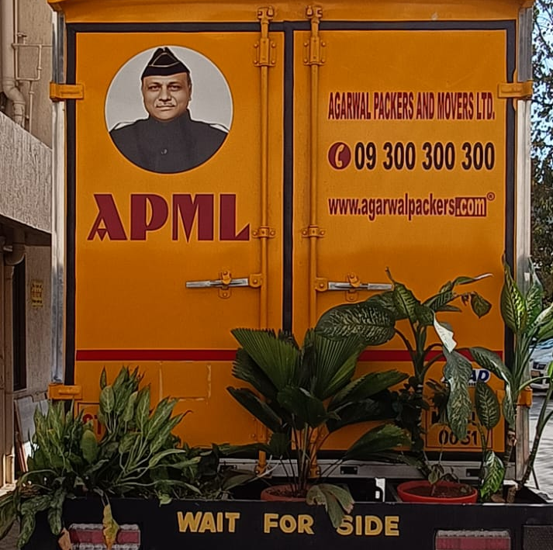
ACCESSORIES THAT MAKE SMART VEHICLE “SMART”
In-built LED Lights for night time loading and visibility.
Safety belts to prevent in-transit goods movements & also prevents de-shaping.
Storage compartment for small utilities as Cushion bags, Spare parts etc.

Slide 8
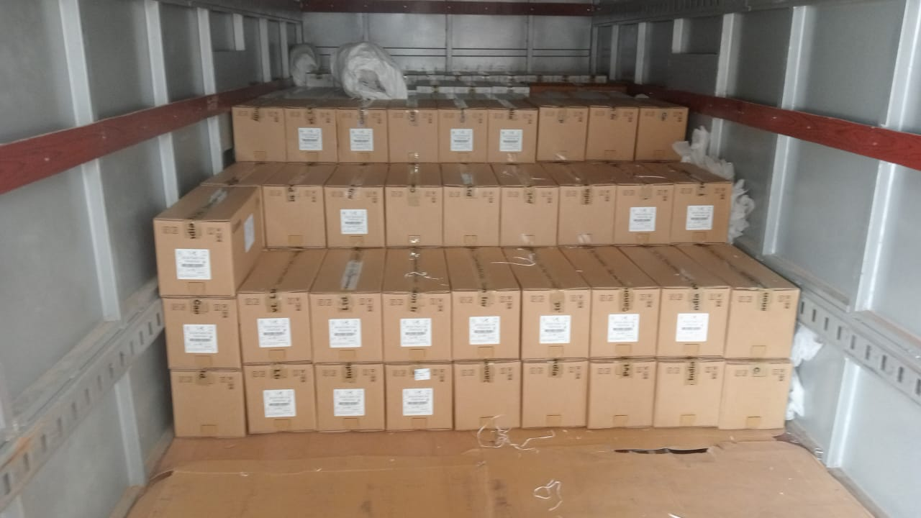
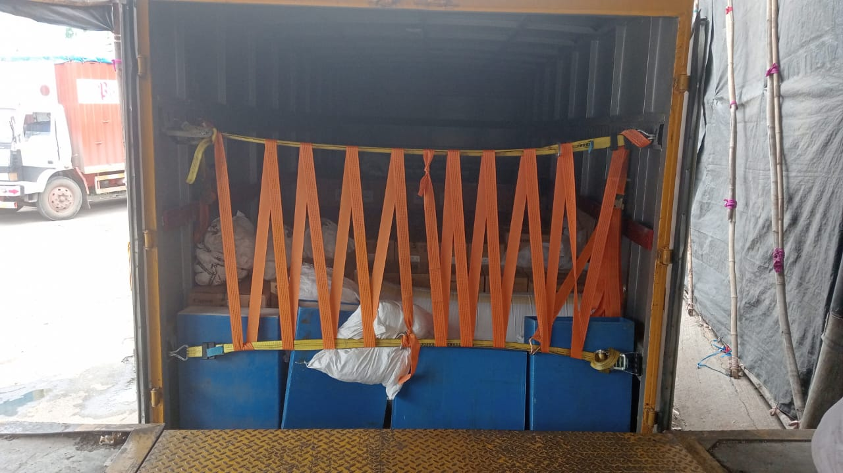
FEATURES THAT MAKE SMART VEHICLE “SMART”
SMART FEATURES
COMPACT
ZERO DAMAGE
ZERO TRANSHIPMENT
WATERPROOF
NO RIGHT TO LEFT DISPLACEMENT OF GOODS
DIRECT POINT TO POINT MOVEMENT
CAN ENTER INTO NARROW LANES
VERY VERY ECONOMICAL

Slide 9
We partner prosperity THANK YOU

